Slide 1
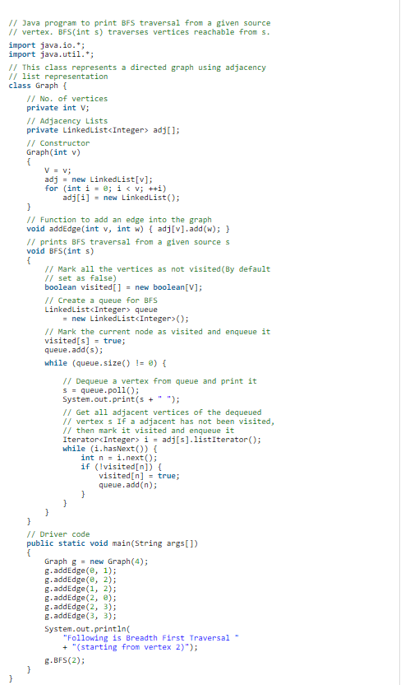
Practicle 1:BFS

Slide 2


Slide 3
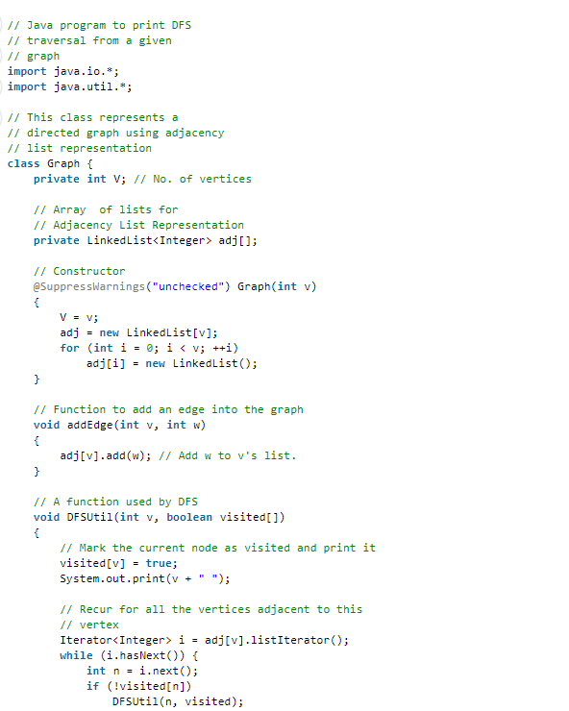
Practicle 1: Deapth first Search

Slide 4
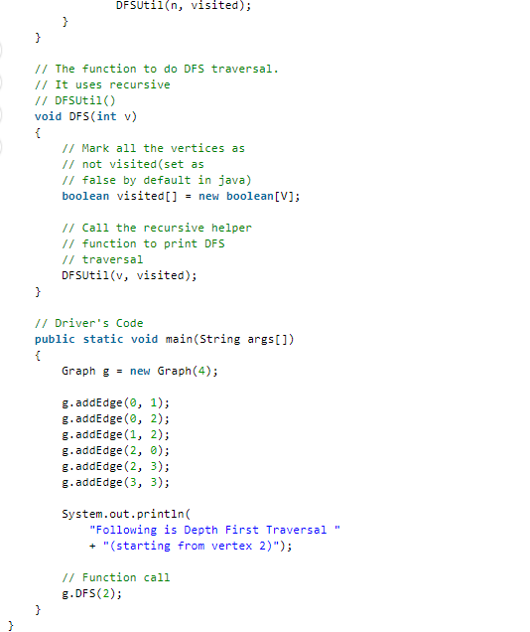

.

Slide 5
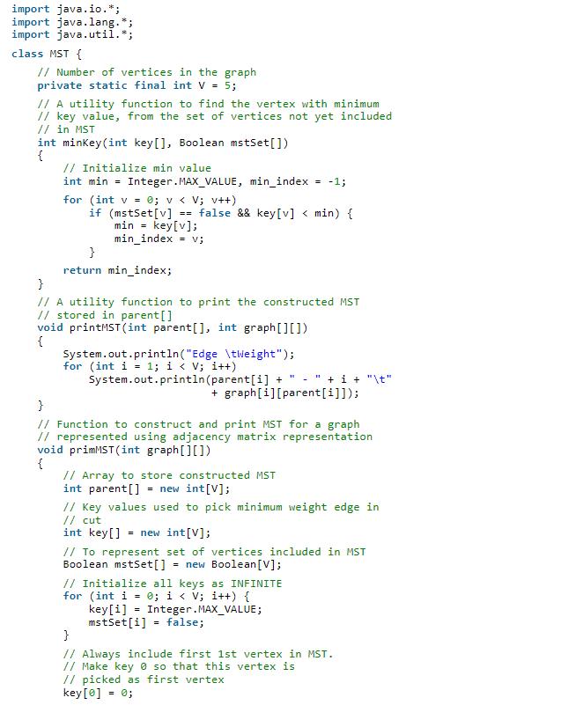
Practicle 3:Minimum spanning tree

Slide 6
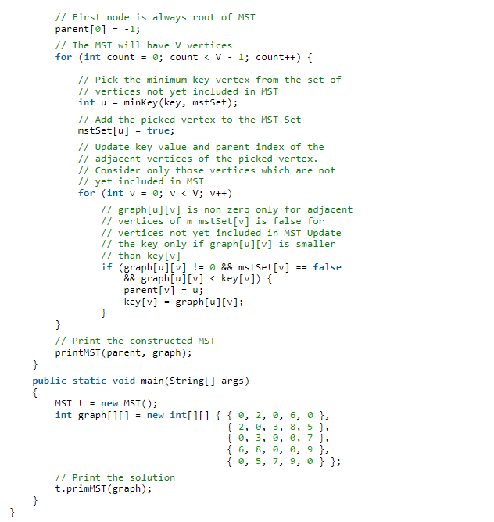

.

Slide 7
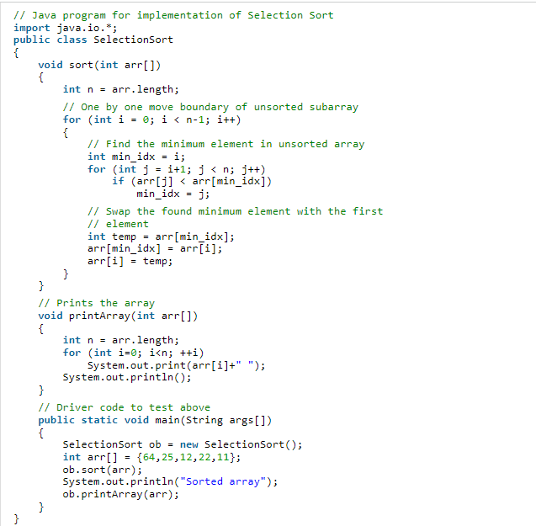

Practile 3:Selection Sort

